Slide 1





Internship report
Cloud Computing and
AWS
VannalaRajesh Reg no : 1 21 03182 B.TECH ( CSE )

Slide 2
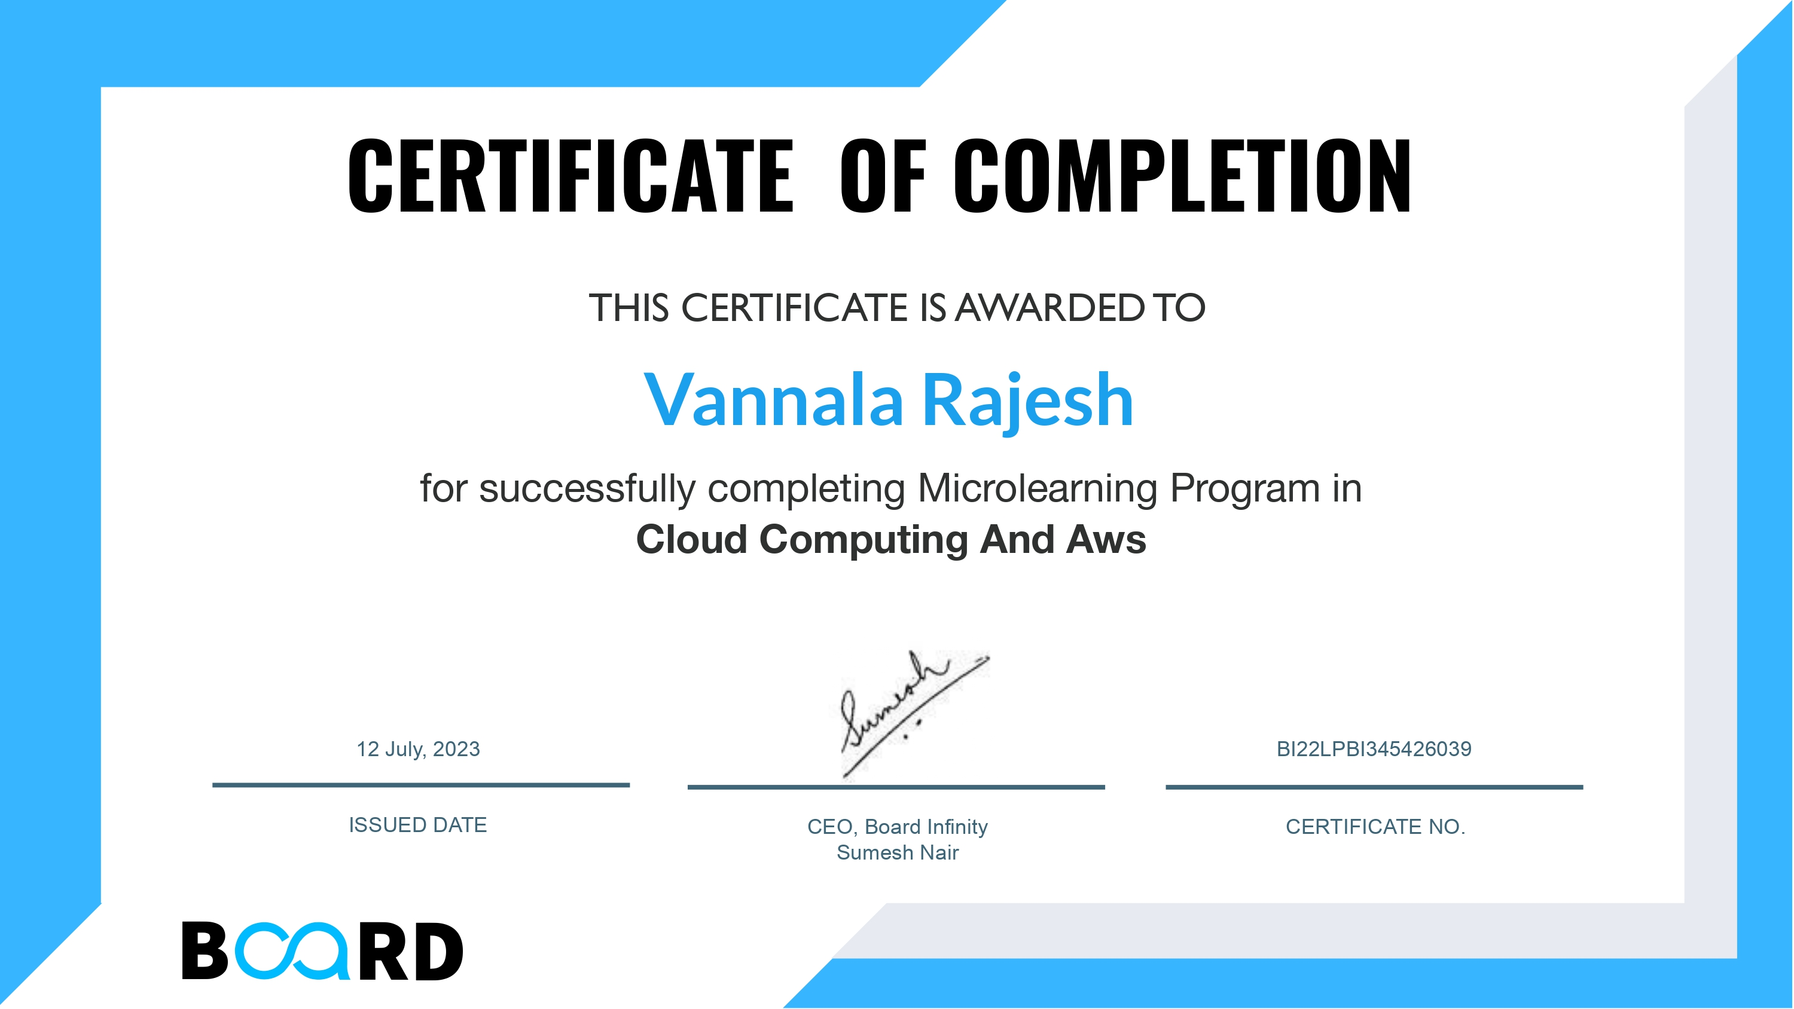

Slide 3

INTRODUCTION
Cloud computing, a transformative technology, has reshaped the way we access and manage computing resources. At the forefront is Amazon Web Services (AWS), a powerhouse in cloud services. AWS Lex is a service provided by Amazon Web Services (AWS) that enables the building of conversational interfaces into any application using voice and text. It is designed to create chatbots, virtual agents, and interactive voice response systems.

Slide 4


OBJECTIVES
The main objective of this internship is getting basic knowledge
about Cloud Computing and AWS Solution Architect Training Certification.
AWS LEX
Identity & Access Management (IAM)
Virtual Private Cloud (VPC) Simple Storage Service (S3) Elastic Cloud Compute (EC2) Elastic Load Balancing (ELB) RDS/DynamoDB (databases) Simple Notification Service (SNS) CloudWatch (monitoring)

Slide 5
AWS LEX: AWS Lex is a service provided by Amazon Web Services (AWS) that enables the building of conversational interfaces into any application using voice and text. It is designed to create chatbots, virtual agents, and interactive voice response systems.
Virtual Private Cloud (VPC): VPC enables you to create a logically isolated section of the AWS Cloud where you can launch AWS resources. It allows you to define your network architecture, including IP address ranges, subnets, and security settings.

Slide 6
Simple Storage Service (S3): S3 is a scalable object storage service that allows you to store and retrieve data. It's commonly used for hosting static websites, storing backups, and sharing large files.
Elastic Cloud Compute (EC2): EC2 provides resizable compute capacity in the cloud. It allows you to launch virtual servers, known as instances, with various configurations to run applications, host websites, and perform computing tasks.

Slide 7
Elastic Load Balancing (ELB): ELB automatically distributes incoming traffic across multiple EC2 instances to ensure high availability and fault tolerance for your applications. It helps balance the workload among different servers.
RDS/DynamoDB (databases):These are database services offered by AWS. RDS (Relational Database Service) provides managed relational databases like MySQL, PostgreSQL, and others. DynamoDB is a NoSQL database service designed for high scalability and performance.

Slide 8
Simple Notification Service (SNS):SNS is a messaging service that enables you to send notifications and messages to a distributed set of recipients. It's often used for sending alerts, event notifications, and broadcasting messages.
CloudWatch (monitoring):CloudWatch is a monitoring and observability service that allows you to collect and track metrics, collect log files, and set alarms. It helps you monitor the health and performance of your AWS resources and applications.

Slide 9
PROJECT

Slide 10
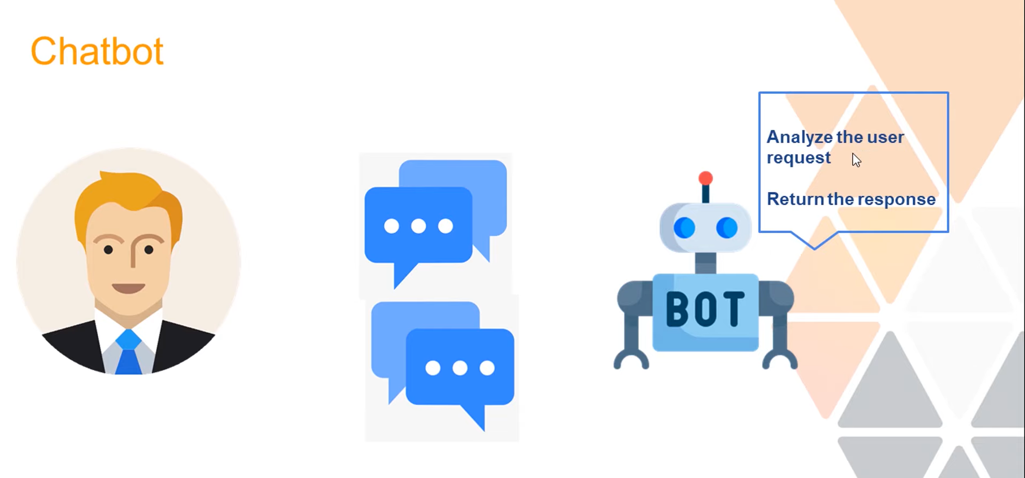

Slide 11
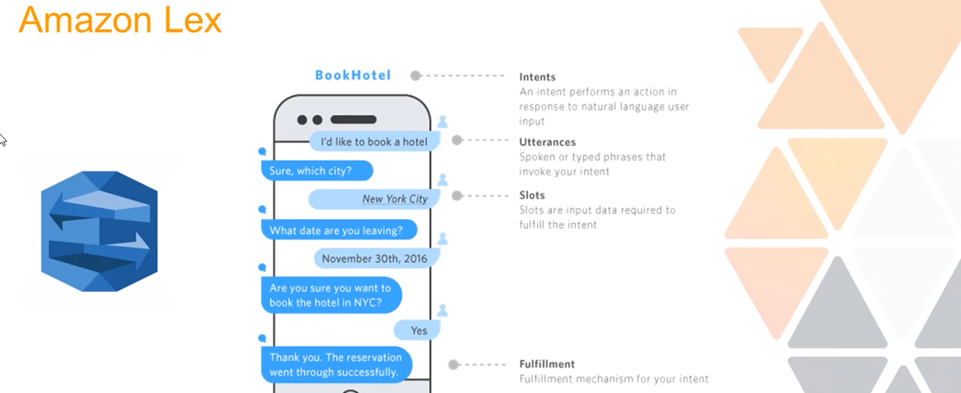

Slide 12
Pizza Ordering chatbot using Aws Lex
The Pizza Ordering Chatbot project introduces an innovative solution to streamline and elevate the pizza ordering experience. Utilizing the capabilities of Amazon Lex, this chatbot engages users in natural language conversations, allowing them to seamlessly place pizza orders with a personalized touch. The key components include specific intents like PizzaType, PizzaCrust, Appetizers, and DeliveryTime, each catering to different aspects of the user's order preferences. For instance, the PizzaType intent captures the desired pizza variety, while the DeliveryTime intent facilitates coordination based on the user's preferred delivery schedule.

Slide 13
A fundamental aspect of the project is the integration of slot types such as PizzaType Slot, PizzaCrust Slot, Appetizers Slot, and DeliveryTime Slot. These slots enable precise extraction of user preferences, ensuring accurate and customized order processing. Users can effortlessly communicate their pizza specifications, including crust preferences, additional appetizers, and preferred delivery times, resulting in an intuitive and user-friendly ordering process.
The chatbot's usage scenarios encompass not only order placement but also real-time updates on order status, time-sensitive delivery coordination, and integration of promotions and recommendations. Moreover, the chatbot serves as a valuable source of data, offering insights into user preferences and popular choices for informed decision-making. Multi-platform accessibility and efficiency during peak periods further enhance the project's appeal, ensuring a convenient and satisfying pizza ordering journey for users.

Slide 14

PROJECT PROBLEM STATEMENT
"In the rapidly evolving digital landscape, our organization grapples with a significant challenge – the need for a more responsive and personalized customer support system. The existing support channels, marked by traditional methods such as email and phone, are proving insufficient to meet the increasing demands of our diverse user base. This inadequacy results in delayed responses, user frustration, and a potential impact on overall customer satisfaction.

Slide 15
Use of project

Slide 16

The implementation of our Pizza Ordering Chatbot revolutionizes the pizza ordering experience, introducing a range of usage scenarios that enhance user engagement and streamline operational processes. Users can now effortlessly customize their pizza orders by specifying pizza type, crust preference, and additional appetizers, with the chatbot's natural language understanding ensuring a seamless and personalized ordering experience. The conversational nature of the chatbot simplifies the order placement process, making it more intuitive and user-friendly. Beyond order placement, the chatbot provides real-time updates on the status of pizza orders, offering users transparency and engagement throughout the delivery process. The inclusion of the DeliveryTime intent allows users to specify their preferred delivery time, facilitating efficient coordination between the user's schedule and pizza delivery.

Slide 17
Moreover, the chatbot integrates promotions and recommendations into the conversation, offering users personalized suggestions for new pizza varieties or special promotions. This not only enhances upsell opportunities but also contributes to a positive and engaging user experience. By providing insights into user preferences, popular choices, and peak ordering times, the chatbot serves as a valuable source of data, enabling data-driven business decisions and strategic planning. With multi-platform accessibility and efficiency during high-traffic periods, the Pizza Ordering Chatbot ensures accessibility, convenience, and operational efficiency, ultimately contributing to an elevated user experience and increased customer loyalty.

Slide 18
Photos of Output

Slide 19
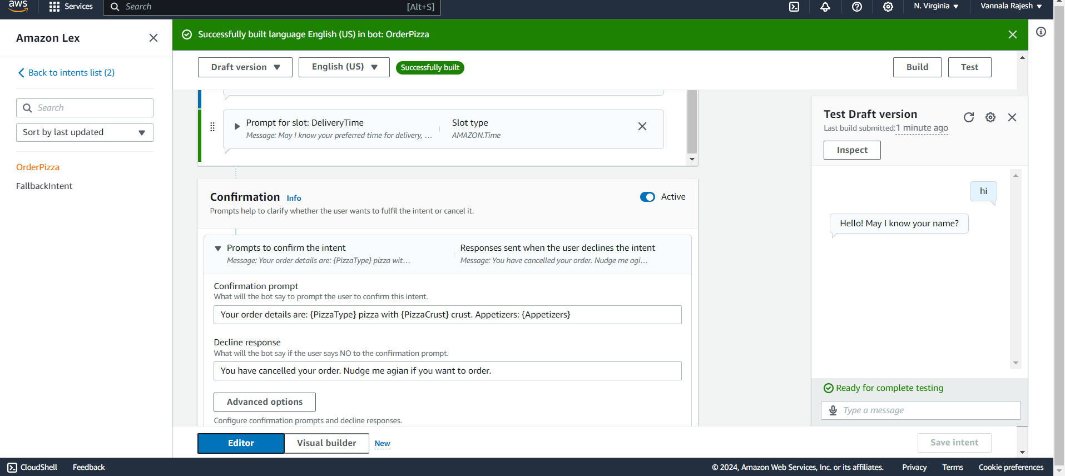
PICTURE 1

Slide 20
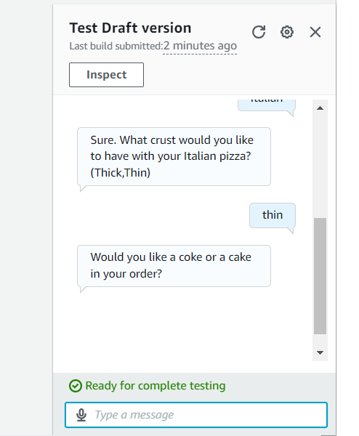
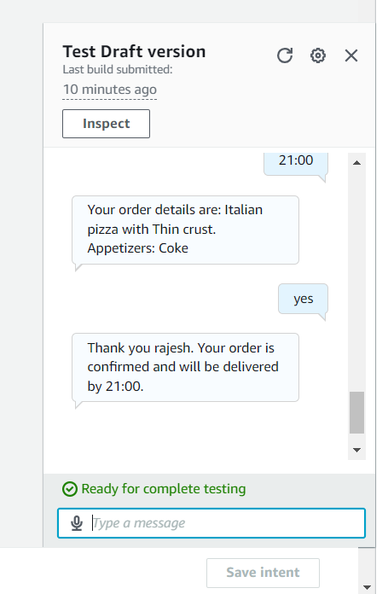
PICTURE 2

Slide 21

CONCLUSION
In conclusion, the Pizza Ordering Chatbot project stands as a testament to the power of conversational AI in transforming the traditional pizza ordering process. By harnessing Amazon Lex, this chatbot not only simplifies the user experience but also adds a personalized touch to each interaction. The strategic implementation of intents such as PizzaType, PizzaCrust, Appetizers, and DeliveryTime, coupled with corresponding slot types, ensures accurate and tailored order processing. Users can seamlessly express their preferences, from pizza varieties to delivery times, in natural language, fostering an intuitive and enjoyable ordering experience.

Slide 22


